Slide 1

HR Analytics: Workforce Performance, Risk Assessment, and Strategic Recommendations
Mohamed Elsayed
Ahmed Said
Alaa Hamdeen
Aya Moustafa
Nada Mahmoud
Transforming Employee Data into Predictive Retention Insights
NHA-ALX3-DAT1-G3

Slide 2
Project Overview & Objectives
To move HR from reactive reporting to proactive, data-driven decision making.
Analyze historical workforce performance and demographics.
Identify operational gaps in management and training.
Predict future employee attrition using Machine Learning.
Analysis of 1,470 employees spanning the years 2013–2022.
List of the 5 key objectives or a simple icon set representing Data -> Insight -> Action.

Slide 3
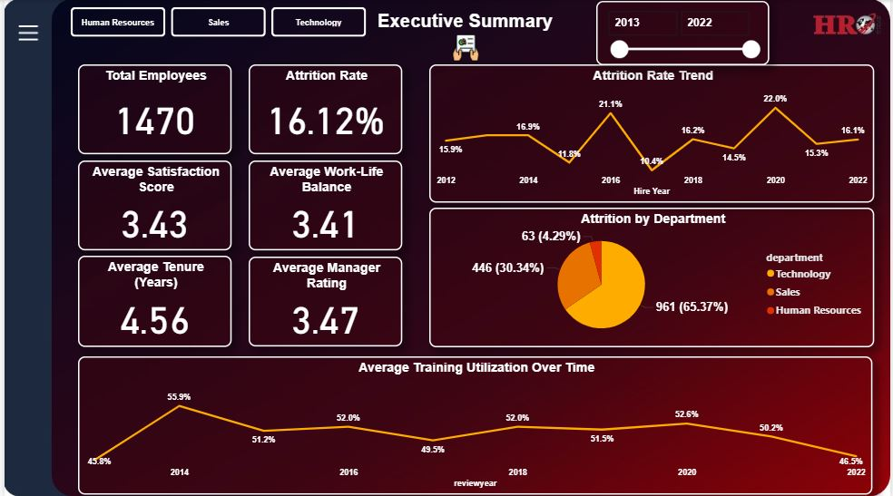
Executive Summary
Current Attrition is 16.12%, but 14% of the Workforce is at Immediate Risk.
Key Metrics:
Overall Attrition Rate: 16.12% (Historical Baseline).
High-Risk Headcount: 208 Employees (Identified by ML Model).
Rating Alignment Gap: 0.51 (Self vs. Manager Perception gap).

Slide 4
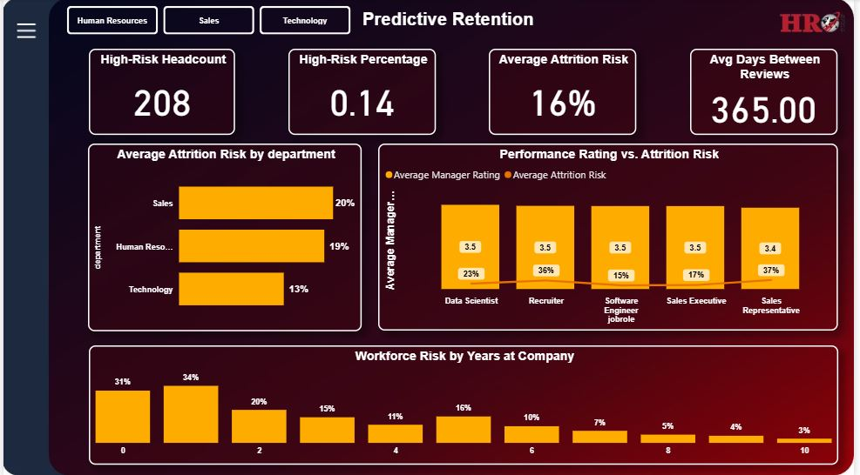
Predictive Risk Assessment
The predictive model has identified specific "High-Risk" employees (Probability ≥ 80%
Risk by Department:
Sales: 20% Avg Risk (Highest).
Human Resources: 19% Avg Risk.
Technology: 13% Avg Risk.
Strategic Implication: Retention efforts must be targeted, not generic.

Slide 5
Critical Vulnerability: Early Tenure
The "Danger Zone" is the First 2 Years.
Both historical data and predictive modeling point to the same failure point.
Year 0 (New Hires): 31% Attrition Risk.
Year 1: 34% Attrition Risk.
Conclusion: The organization is failing to engage employees during the onboarding and initial development phase.

Slide 6
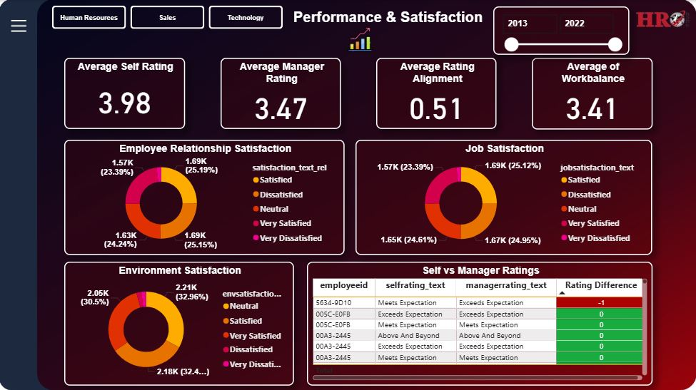
Operational & Performance Gaps
Management Alignment & Training Issues.
Rating Disconnect:
Avg Self Rating: 3.98 vs. Avg Manager Rating: 3.47.
Gap (0.51): Employees think they are performing better than managers do, leading to review-time dissatisfaction.
Training Decline:
Training utilization has dropped from a peak of 55.9% (2014) to 46.5% (2022).

Slide 7

Strategic Recommendations
Targeted Retention Intervention:
HR to pull the list of Top 208 High-Risk Employees.
Conduct "Stay Interviews" specifically for Sales and HR departments.
2. Manager Calibration Training:
Launch training to fix the 0.51 Rating Gap. Managers must communicate feedback before the formal review.
3. Revamp Onboarding (0-2 Years):
Implement 6-month and 12-month check-ins to stop the 34% early attrition bleed.

Slide 8

Impact & Next Steps
Expected Impact:
Reduction in early-tenure turnover.
Improved manager-employee relationship scores.
Data-driven allocation of training budget.
Next Steps:
Deploy dashboard to Department Heads.
Begin screening of High-Risk list immediately.

Slide 9


